Slide 1
Supplementary Class 3
Review Excel Functions
For Chapters 3 and 4

Slide 2
Review of Excel Functions

Slide 3
PV function for PW
Present Worth (PW) is a method of choosing alternatives based on comparison of the Present Value (PV) of each alternative.
You simply enter the cash flows at each time into Excel and find the PV, the value at the beginning of the analysis period, of each cash amount by using the P = F (1 +i)^-n
Then sum those value and that is the PV of those cash flows
“Time zero” is the beginning of the analysis period

Slide 4
I am due to receive $500 at the end of the next three years, how much that worth today, if i = 4.5%?
Time | Cash flow | Value at Time 0, algebra | See Excel, sheet 3-1 | Calculated
0 |  |  |  | $1,374.48
1 | 500 | =500 (1+0.045)^-1 | $ 478.47
2 | 500 | =500 (1+0.045)^-2 | $ 457.86
3 | 500 | =500 (1+0.045)^-3 | $ 438.15
So the PV of that cash flow is less than $1500. If the i was greater, the value would be less, for example if i = 20% the PV would be only $1,053.24 Excel trick. In order to lock a cell, highlight the cell address and use “F4.” You can cycle through F4 again to lock just the rows, or again to lock just the columns.

Slide 5
Here is a Cash Flow Diagram
0
1
2
3

Slide 6
[To see the calculations, double click to open in Excel]

Slide 7
PV function
If the cash amounts are uniform, as those were, you can use the Excel function “PV” to get the same result.

Slide 8
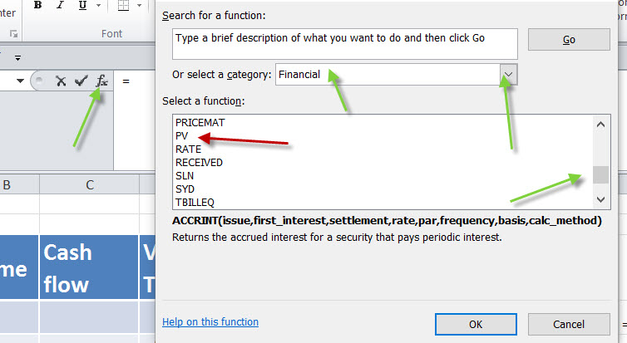
Click on an empty cell, then click on the little “f” for function, then when you get the search for function, use the dropdown to find the Financial functions, then the scroll bar to find PV.

Slide 9
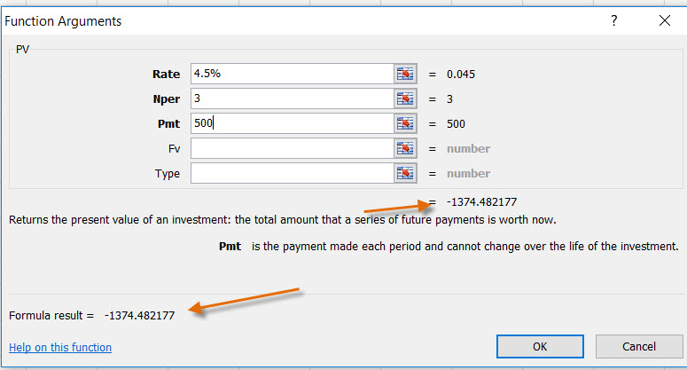
For the function, type in the Rate, which is the “i” of 4.5% (you could use that or 0.045), the number of payments, and their uniform amount. The result is found inside the function parameter box and also in the cell, once you click “OK”

Slide 10
Notes
The Excel function assumes you are making payments on a loan, while we are using the function to convert value of money over time, so the answer is returned as a negative. Change that as you want.
The red font is sometimes used by accountants to indicate a negative, sometimes they use brackets to indicate negative and sometime both.
Change your defaults in Format Cells and Number to suit yourself.

Slide 11
Cash Flow Diagram for Typical Loan Payment
My cash flow is in, positive, when I get the money from the bank, and negative when I make my payments.
0
1
2
3

Slide 12
From Excel, double click

Slide 13
Also
The Excel functions have excellent Help functions

Slide 14
Fun with PV
We generally use the “end-of-period” convention.
Cash flows often come in over the entire period, but we compute as if they call came at the end.
This is convenient. However, if we wanted more detail, we would just use more periods, such as weekly or even daily.

Slide 15
Future value
I could ask, how much money would have in the bank if I payed $100 into savings each month?
Say for 18 months if the bank payed me 8% per year interest.
Start by realizing 8% per year must be converted to month, which is just 8%/12. (That 8% per year is sometimes called on TV the APR, annual percentage rate.)
[Never, never, never, use that “effective” interest rate here, or anywhere else, except in the rare problems that ask you to computer the “effective interest rate.” I meant never. ]

Slide 16
Cash flow for deposits
Note the wording combined with our end-of-period convention means you make a payment and withdraw the works on the last day.
2
3
4
5
17
18
1
0

Slide 17
You could solve this using formulas in Excel or the built in FV function. Next will show you both methods.
See trick to drag the time, using 18 less the current time.
Also, in the function I used the cell addresses rather then typing in the number.

Slide 18
Double click to open Excel

Slide 19
Goal Seek
Suppose in the last problem I wanted to have $2500 in the bank. How much would I need to put in each month?
I could set up the sheet has before, but make the monthly payment a reference cell. I might start with $100, then use trial and error until I got the final amount to reach $2500.
Or, Excel has a trial and error tool called “Goal Seek” in the Data tab, then What-if Analysis.
Goal seek is a trivial version of Excel’s powerful Solver function, which we won’t use in this course.

Slide 20
PMT
But an even easier way to determine the payment is Excel’s PMT function. That will translate a Present Value or Future Value into a uniform payment, A.
Need to think about the signs, though
PMT thinks you are making a loan payment, which is negative to you, thus will return a positive. If you are just using PMT to convert a P or F into an A, you’ll need to change the signs.

Slide 21
PMT

Slide 22
Check

Slide 23
NPV
With the PMT function and either the PV or FV functions, you can move money through time with a minimum of computation. However,
The PV and FV functions require that the payments be equal, as they were in the examples above.
If they payments were not equal, you could still use the compound interest formula, but there is an easier way.

Slide 24
The NPV function allows you to find the value at time zero of uneven cash flows, including positive and negative cash flows.
The only caution is that the function always reports the value one time step earlier, so you need to exclude time zero from the function, then add it back in.
(And also, don’t skip cells, put in a zero if there is no cash flow.)

Slide 25
How much would you pay for an investment that returned $5000 the first year, $9000 the second, had special expenses the third year, so it cost you $2000, and you receive $12,000 from year four, including your receipts and the sale, if your MARR is 15%?
You buy the business at time zero, so were asking what is the Present Worth of those cash flows.

Slide 26
Double click

Slide 27
Here we were seeking the value at time zero, so the caution about excluding that value is not important. However,
Often in our calculations there is a large payment at time zero, the Initial Cost, and a large error can accrue if that is included in the NPV function.

Slide 28
Service Life and Salvage Value
Most capital investments will have a service life. Certainly we will need to assume some life of the investment.
At the end of the life, we will sell the investment for what it is worth. That is the Salvage Value. It could be zero or even negative if there is some demolition or disposal cost.

Slide 29
For computational simplicity, often the PV of the SV is determined and subtracted from the Initial Cost.
With NPV function it used that is not necessary.
Often, just for computational simplicity, if we are dealing in all costs, we leave all the cash flows positive, since we know they are costs. In that case, the SV is sometimes carried as a negative.

Slide 30
See next file for Comparison of Alternatives

